Slide 1
UNIVERSITY OF WISCONSIN–MADISON
Emotion detection
using Convolutional Neural Networks
Harsh Sighal (hsinghal@wisc.edu)
Naman Agrawal (nagrawal8@wisc.edu)

Slide 2
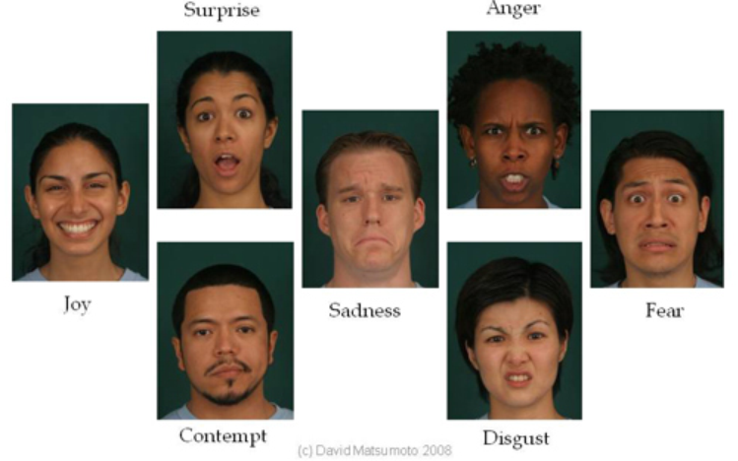
EMOTIONS IN FACIAL EXPRESSIONS
Human facial expressions can be easily classified into 7 basic emotions:
Happy
Sad
Surprise
Fear
Anger
Disgust
neutral
- By American psychologist Paul Ekman (in the 60’s)

Slide 3
MOTIVATION
Our facial emotions may often contain a lot of information about our state of mind and about our likes and dislikes.
Facial emotion recognition / mood recognition can easily and cheaply measure the effects that content, services and operations are having on the audience/users.
Useful in evaluating customer interest, patients' emotional state and audience engagement in events to consistently create desired content based on feedback.

Slide 4
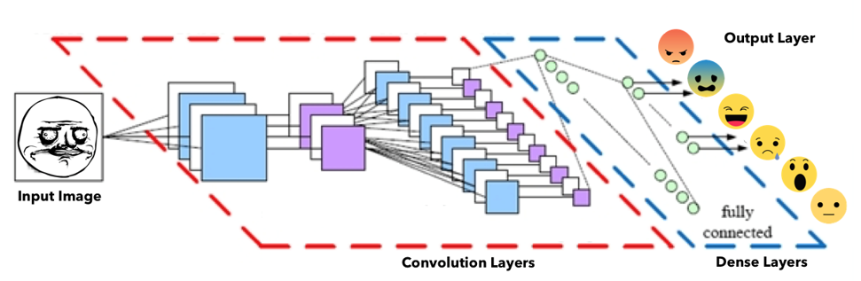







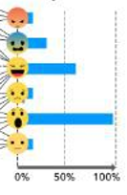
OVERVIEW
Resize to
(48, 48, 3)
Input Image
Face Extraction
Grayscale
(48, 48, 1)
Rage Face
resized to match
Face dimensions

Slide 5
MODEL
Deep learning is a popular technique used in computer vision.
We chose convolutional neural network (CNN) layers as building blocks to create our model architecture because CNNs often mimic how the human brain works when analyzing visuals.
A typical architecture of a convolutional neural network will contain 4 main categories of layers - an input layer, some convolutional layers, some dense layers and an output layer.

Slide 6
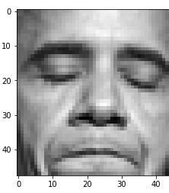
INPUT LAYER
The input layer has pre-determined, fixed dimensions, so the image must be pre-processed before it can be fed into the layer.
We used OpenCV, a computer vision library, for face detection in the image.
The haar-cascade_frontalface_default.xml in OpenCV contains pre-trained filters and uses Adaboost to quickly find and crop the face.
The cropped face is then converted into grayscale using cv2.cvtColor and resized to 48-by-48 pixels with cv2.resize. This is done to reduce the dimensions compared to the original RGB format with three color dimensions (3, 48, 48)
The pipeline ensures every image can be fed into the input layer as a (1, 48, 48) numpy array and processing is faster.

Slide 7
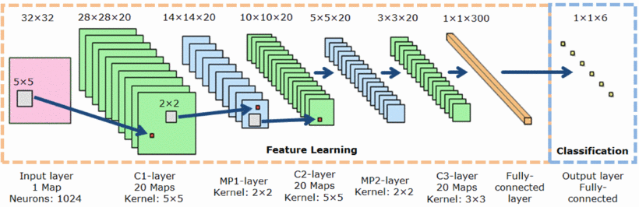

Slide 8
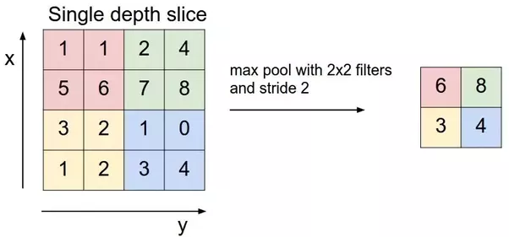

Slide 9
CONVOLUTION LAYERS
Initializes features
The numpy array gets passed into the Convolution2D layer where we specify the various deep learning hyper-parameters.
A Set of filters (3, 3 each), slides across the original image with shared weights to create a feature map.
Convolution generates feature maps that represent how pixel values are enhanced, for example, edge and pattern detection.
Then Pooling method called MaxPooling2D is used that slides (2, 2) windows across the feature map only keeping the maximum pixel value. The pooled pixels form an image with dimensions reduced by 4.

Slide 10
DENSE LAYER
(OR THE FULLY CONNECTED LAYER)
Trains the model weights and propagates loss
In these layers, weights are trained by Forward propagation of training data then backward propagation of its errors.
Back propagation starts from evaluating the difference between prediction and true value, and back calculates the weight adjustment needed to every layer before. We can control the training speed and the complexity of the architecture by tuning the hyper-parameters, such as learning rate and network density.
As we feed in more data, the network is able to gradually make adjustments until errors are minimized.

Slide 11
OUTPUT LAYER
We used softmax activation function at the output layer.
This output presents itself as a probability for each emotion class.
Therefore, the model is able to show the detail probability composition of the emotions in the face.
We found that it is not efficient to classify human facial expression as only a single emotion. Our expressions are usually much complex and contain a mix of emotions that could be used to accurately describe a particular expression.

Slide 12
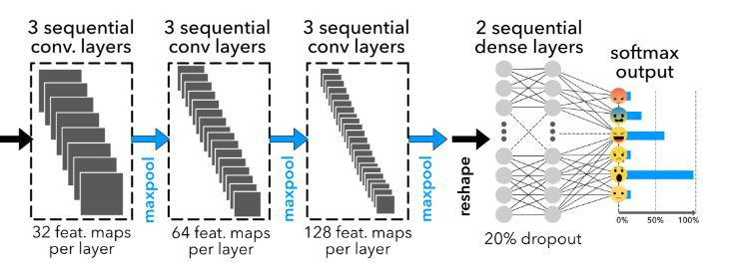

Slide 13
DATASET
The dataset we used for training the model is from a Kaggle Facial Expression Recognition Challenge a few years back (FER2013).
It comprises a total of 35887 pre-cropped, 48-by-48-pixel grayscale images of faces each labeled with one of the 6 emotion classes: anger, fear, happiness, sadness, surprise, and neutral.

Slide 14
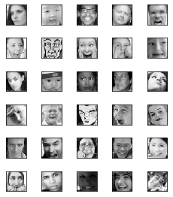
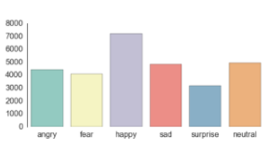

Slide 15
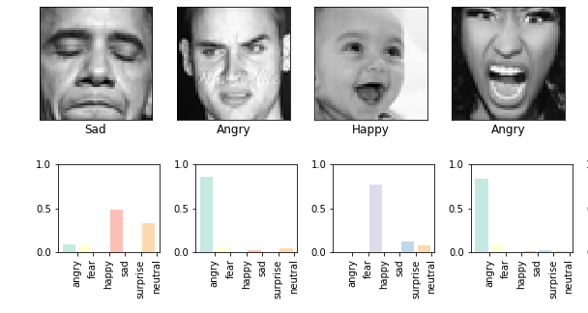
SAMPLE RESULTS

Slide 16
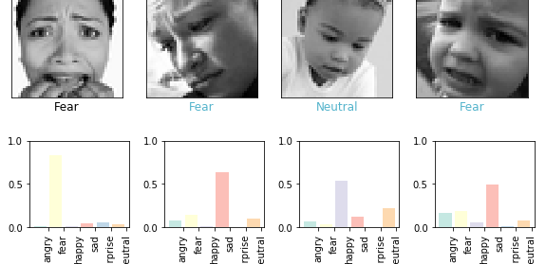
MORE SAMPLE RESULTS

Slide 17
MODEL VALIDATION (Accuracy)
The final CNN had a validation accuracy of 58%.
Because our expressions usually consist a combination of emotions, and only using one label to represent an expression can be hard.
In this case, when the model predicts incorrectly, the correct label is often the second most likely emotion

Slide 18
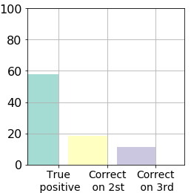
ACCURACY

Slide 19
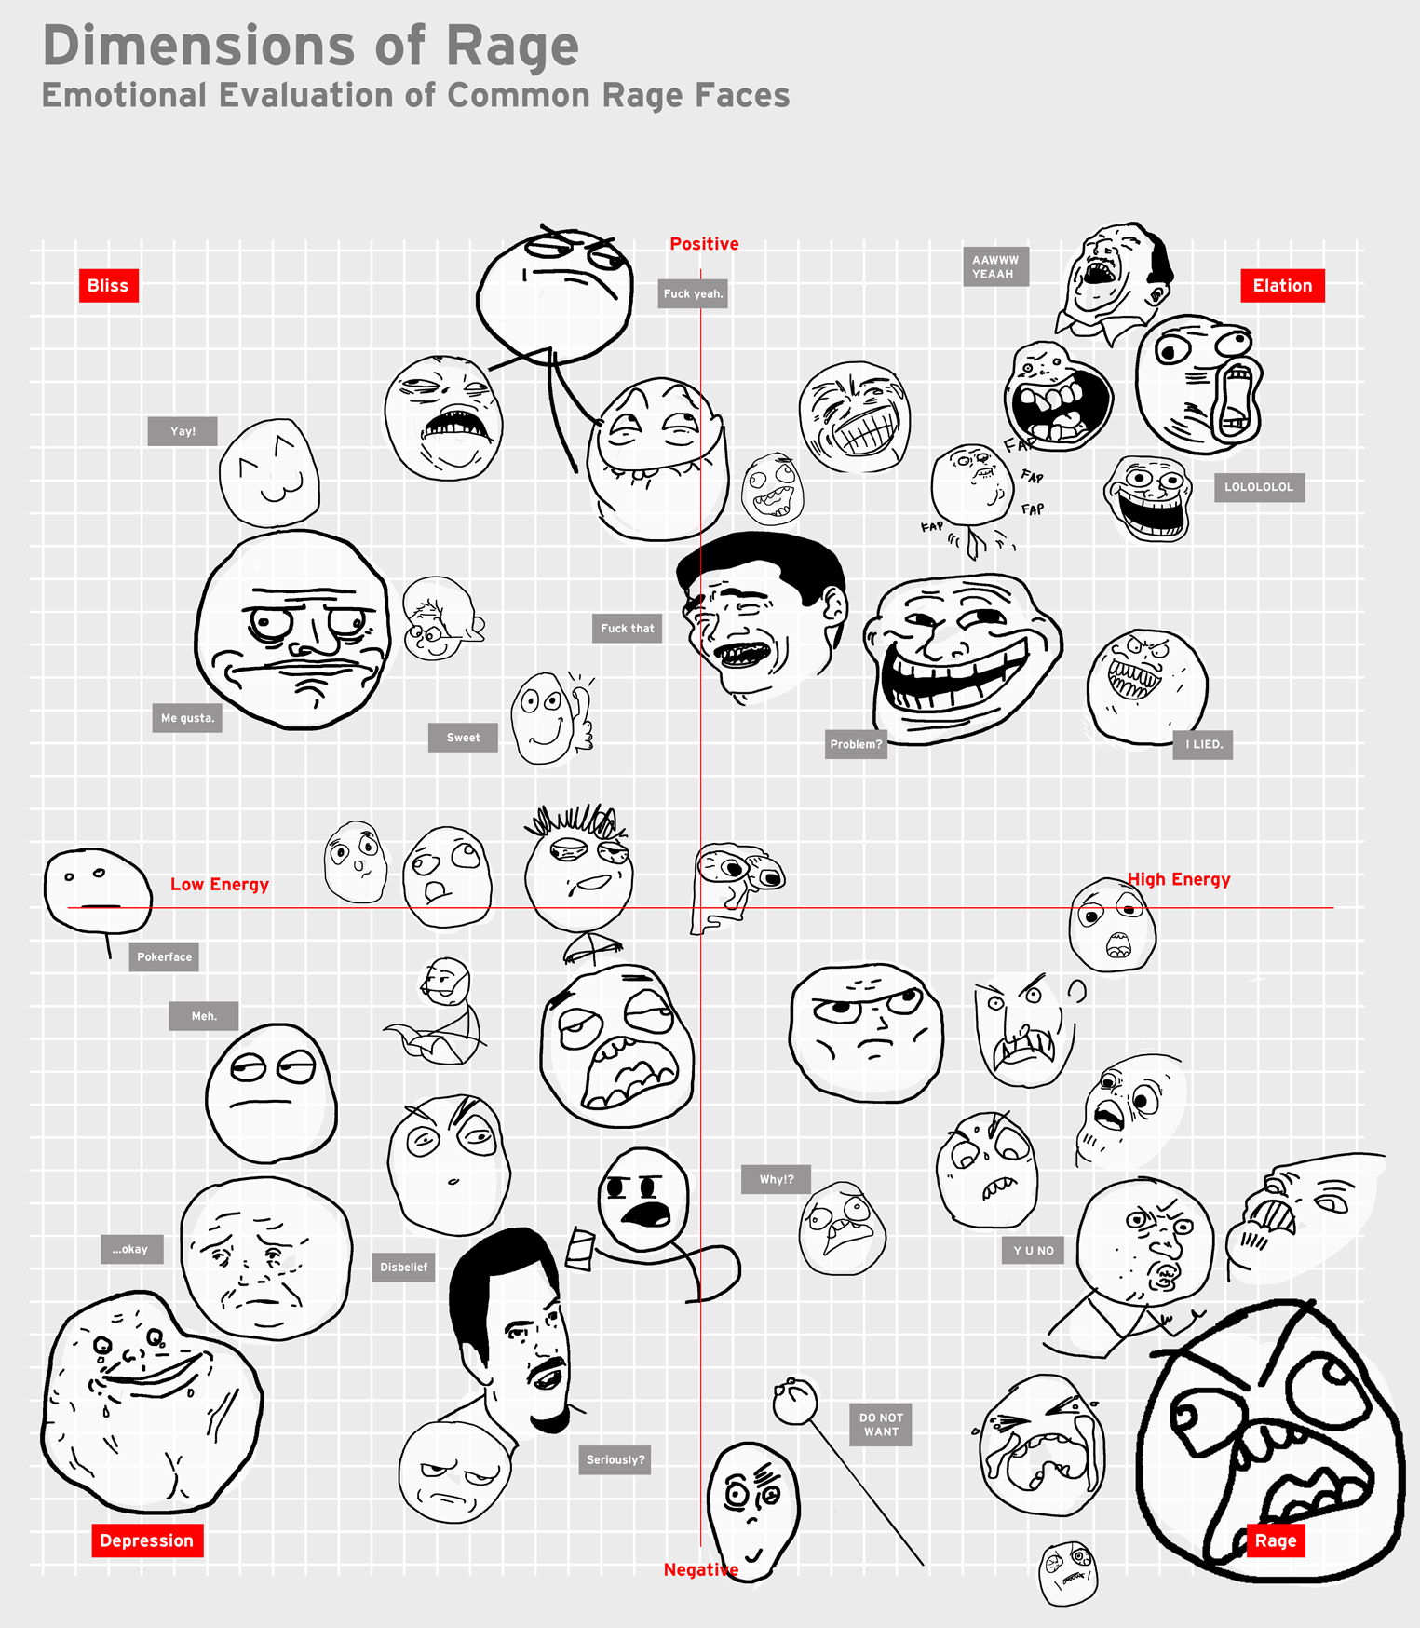

Slide 20
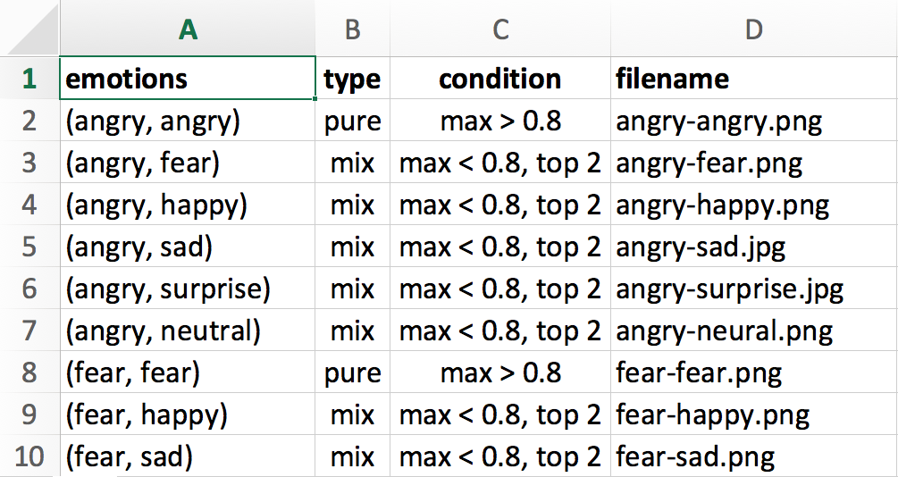

Slide 21

DEMONSTRATION

Slide 22
SCOPE FOR IMPROVEMENT
Carry out Machine Learning for more number of epochs for better accuracy.
Since CNN requires a very large data set for good accuracy, try to use a larger, cleaner and a diverse dataset for better results.
We can use GPU for faster computations on a larger dataset for a better accuracy.
Collect detected emotion of each frame (or frame after a time interval) and use that data to predict the overall mood of the person. It can also be used for lie detection problem.

Slide 23
CURRENT USECASE IN THE INDUSTRY
A lot of work is being done currently, both academically and industrially, in this field of emotion detection such as sentiment detection and consumer reaction on advertisements.
Last year, Apple bought Emotient, ‘a startup company that utilises artificial intelligence to analyze facial expressions and read emotions'. Companies such as Affectiva in the USA, and CrowdEmotion in the UK are doing similar work.

Slide 24
REFERENCES
"Dataset: Facial Emotion Recognition (FER2013)" ICML 2013 Workshop in Challenges in Representation Learning, June 21 in Atlanta, GA.
"Andrej Karpathy's Convolutional Neural Networks (CNNs / ConvNets)" Convolutional Neural Networks for Visual Recognition (CS231n), Stanford University.
Srivastava et al., 2014. "Dropout: A Simple Way to Prevent Neural Networks from Overfitting", Journal of Machine Learning Research, 15:1929-1958.
Duncan, D., Shine, G., English, C., 2016. "Report: Facial Emotion Recognition in Real-time" Convolutional Neural Networks for Visual Recognition (CS231n), Stanford University.
http://www.apa.org/science/about/psa/2011/05/facial-expressions.aspx
https://9gag.com/gag/3539317/emotional-evaluation-of-common-rage-faces

